Slide 1
Sprint Review – Team A

Slide 2
Goals of Sprint Review/Retro
Review: Demo each “story” (task/requirement) to product owner for acceptance
Retro: reflect on sprint, suggest changes for process improvement

Slide 3
Problem Significance
Task: estimate the circumference and area of a circle without using Pi
Goals:
Accomplish task
Familiarize ourselves with GitHub and agile principles
Improve software development skills

Slide 4
Algorithm Functions
get_circle_inputs(): user enters values—if they are incorrect, an error message pops up and they repeat entry
estimate_circ(): circle circumference is approximated to be compared with actual circumference
estimate_area(): circle area is approximated to be compared with actual area

Slide 5
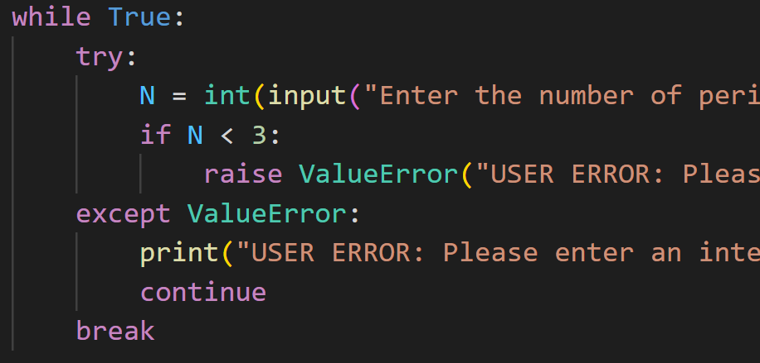
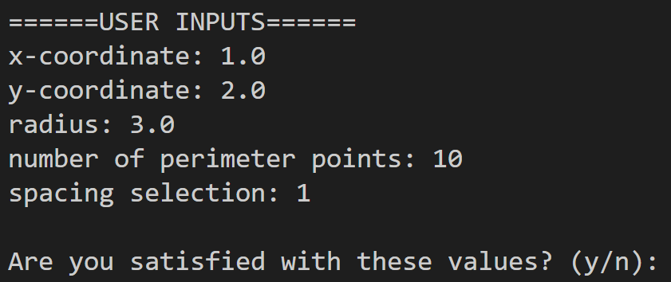
User Inputs
Try-except statements were used to catch user errors and make the user try again if the type of input is incorrect
After entering their inputs, the values are printed, and the user has the option to try again

Slide 6

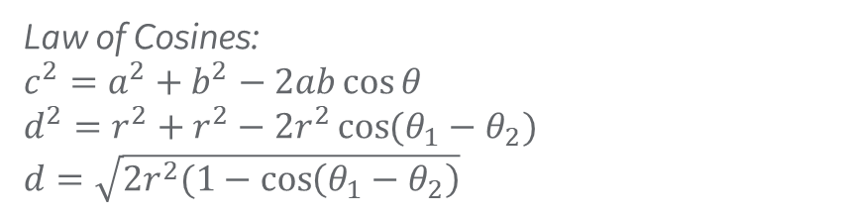


Numerical Methods
$θ$= $θ$₂
d
r
$θ$= $θ$₁
$θ$=0
Law of Cosines:
$c^{2}=a^{2}+b^{2}−2ab\cos{θ}$
$d^{2}=r^{2}+r^{2}−2r^{2}\cos{(θ_{1}−θ_{2})}$
$d=\sqrt{2r^{2}(1−\cos\left(θ_{1}−θ_{2}\right)}$
Circumference Estimation
Area Estimation

Slide 7
Extending the Algorithm

Slide 8
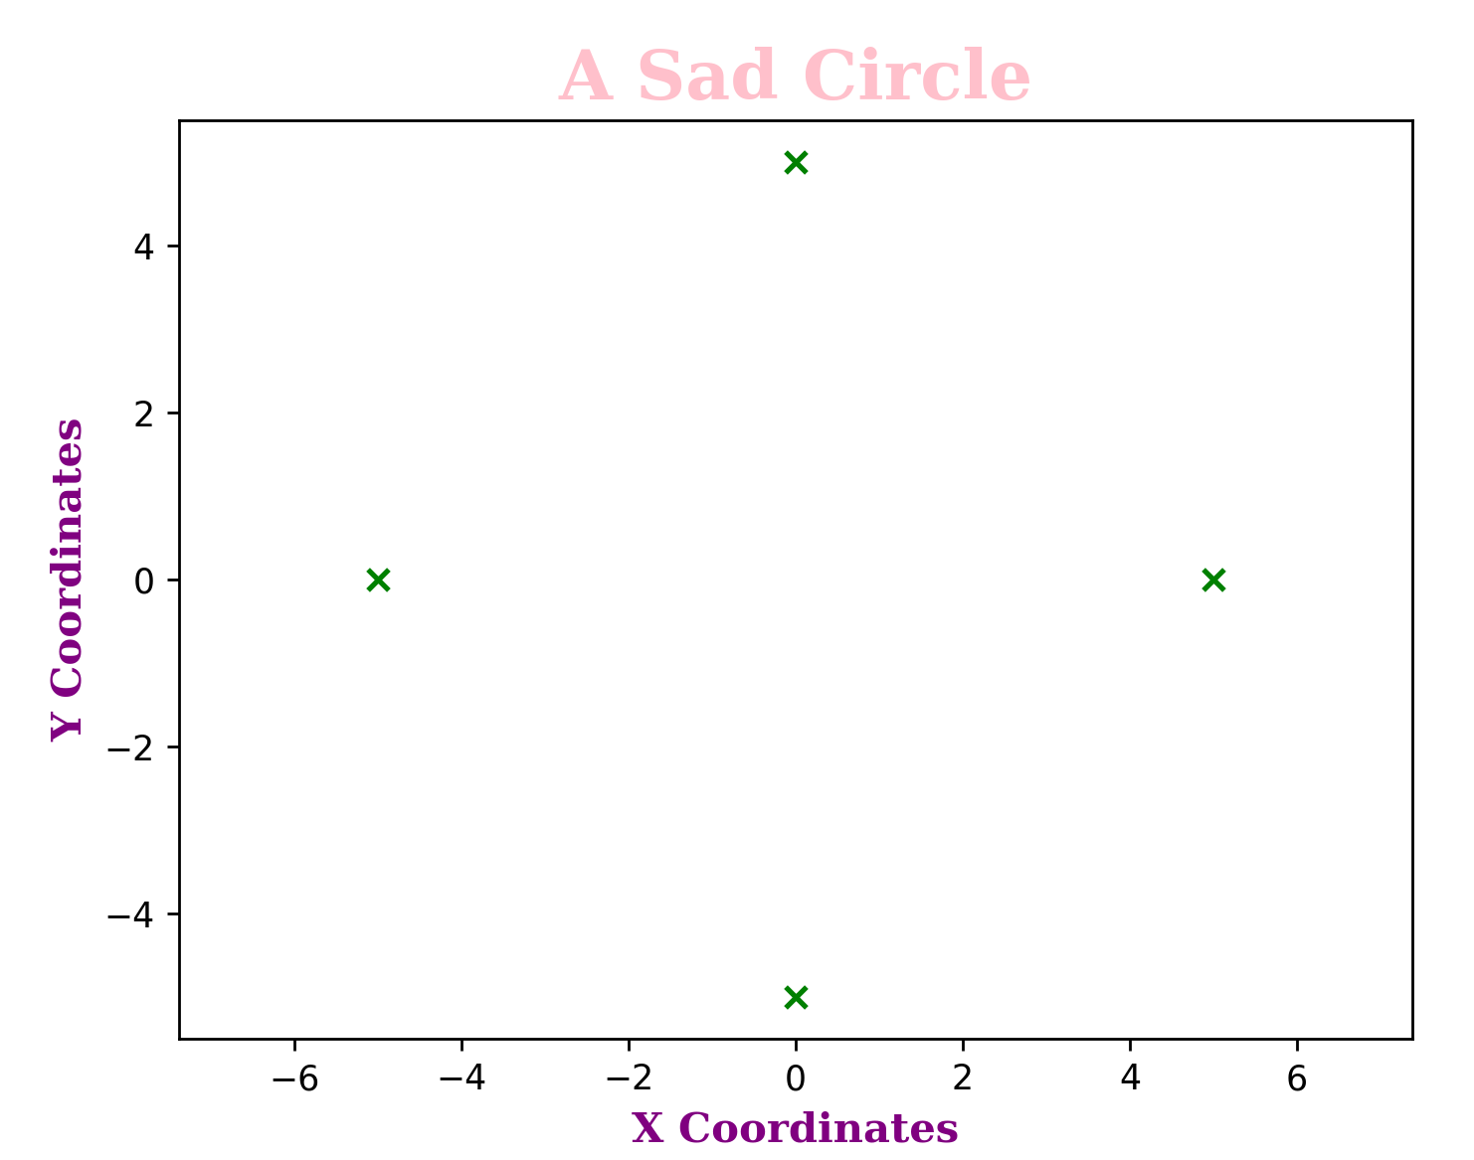
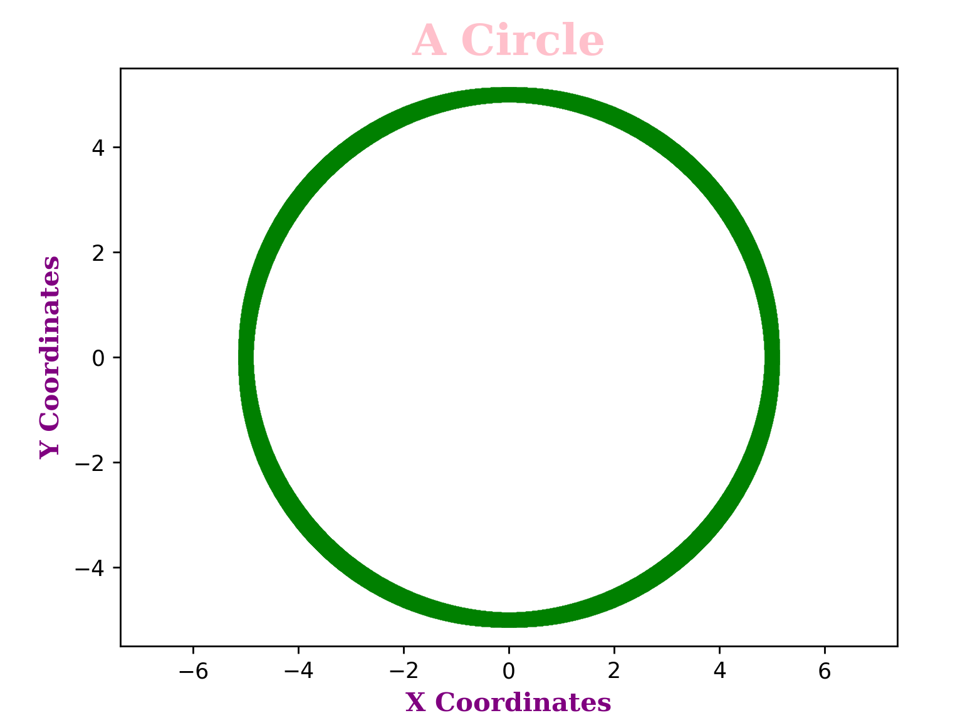
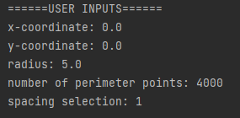
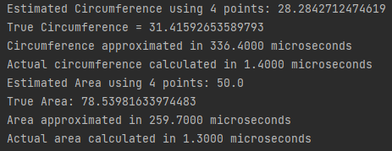
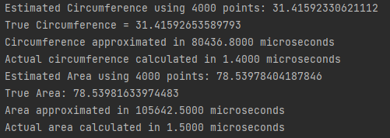
Input Parameter Impact on Results

Slide 9
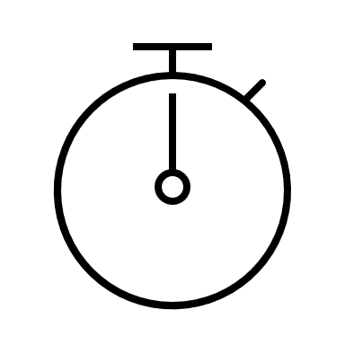

Function timers
Use of timer Python library to determine run time of each function
Example of timer encapsulating circumference function
tic_circ = time.perf_counter()
estimate_circ(r,n,choice)
toc_circ = time.perf_counter()
t_calc = (toc_circ - tic_circ) * 10 ** 6
print(f "Circumference approximated in {t_calc:0.4f} microseconds")
Timer started
Function call to circumference estimation
Timer ended
Timer Start – Finish (in microseconds)
Print statement
Same code used to encapsulate area estimation function

Slide 10
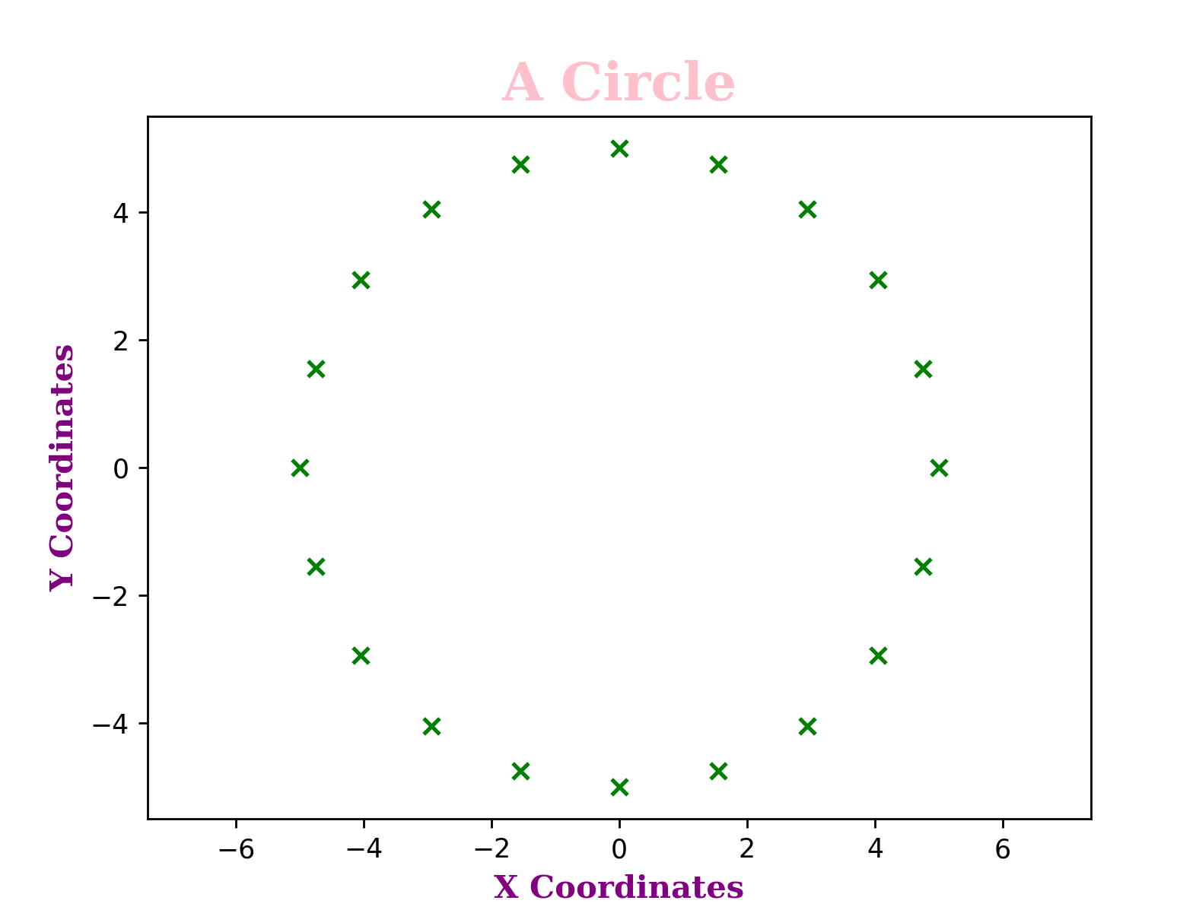
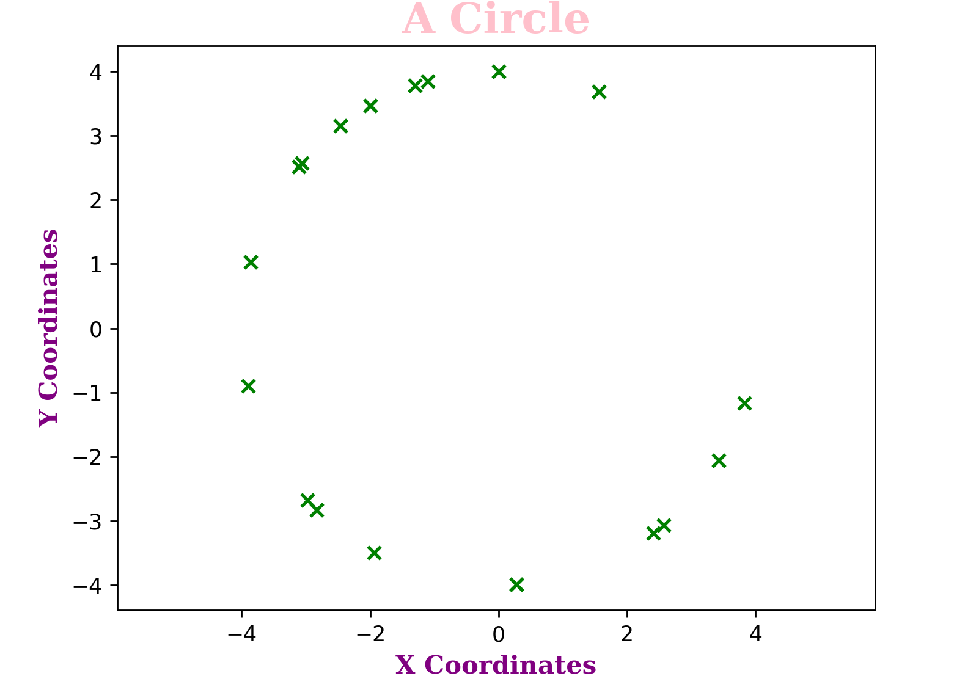
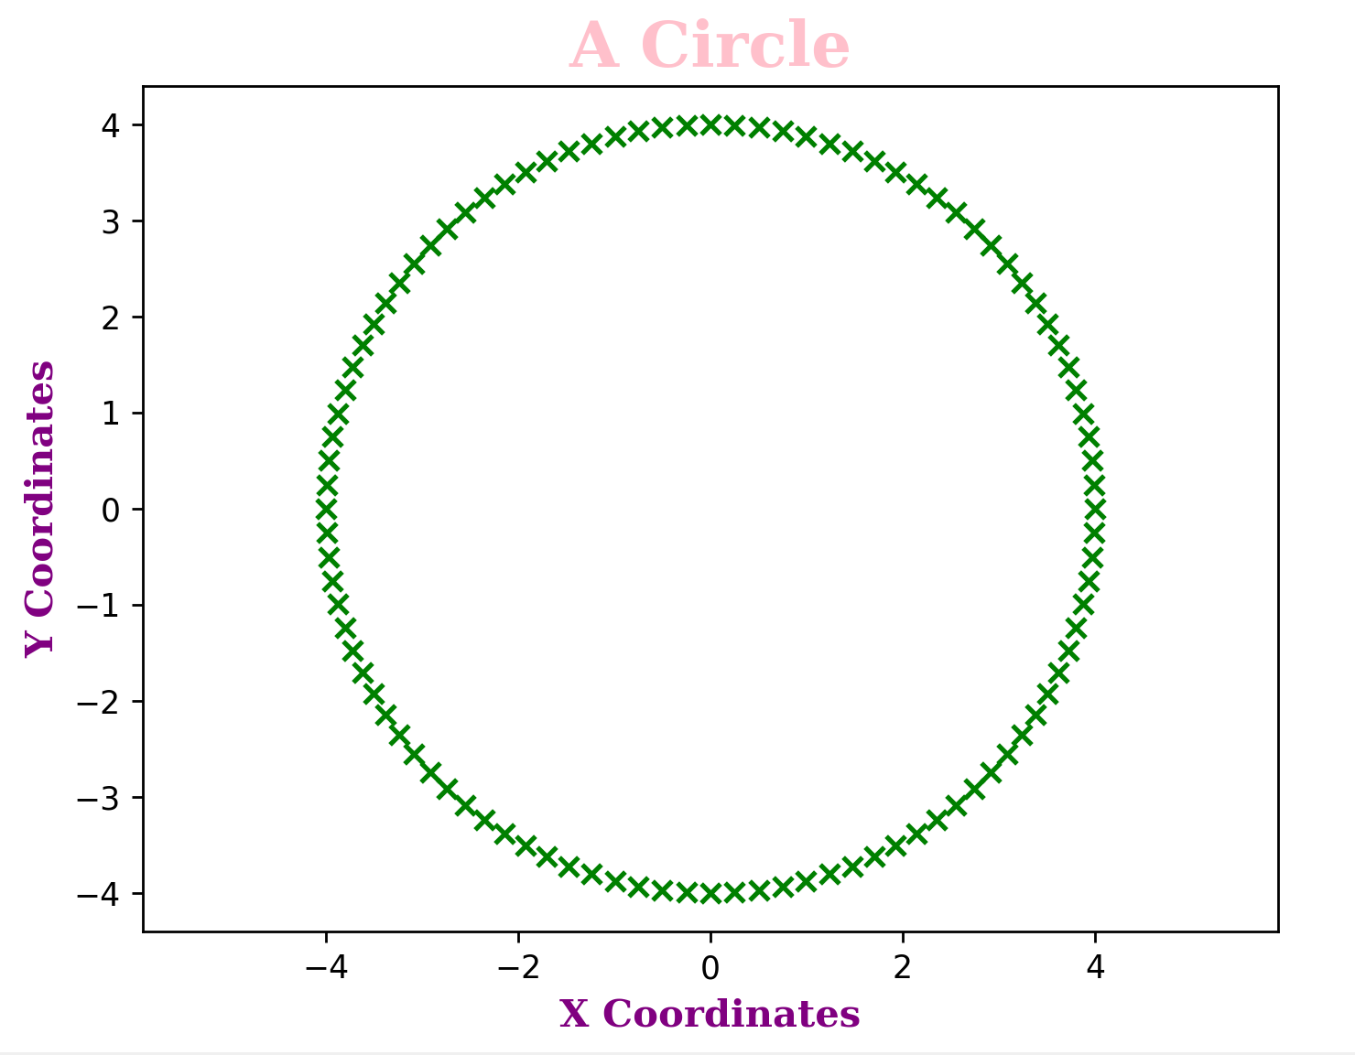
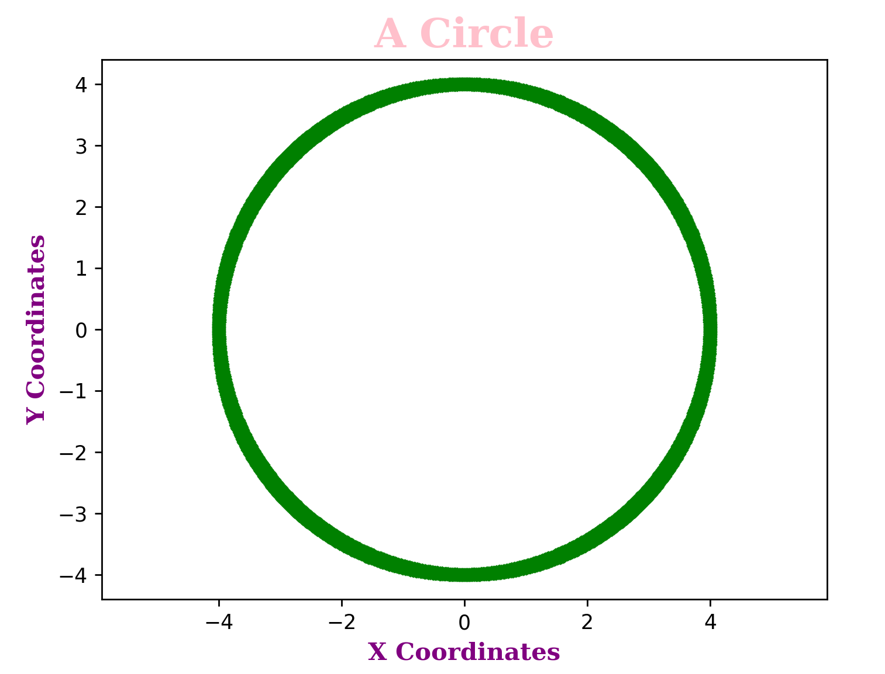
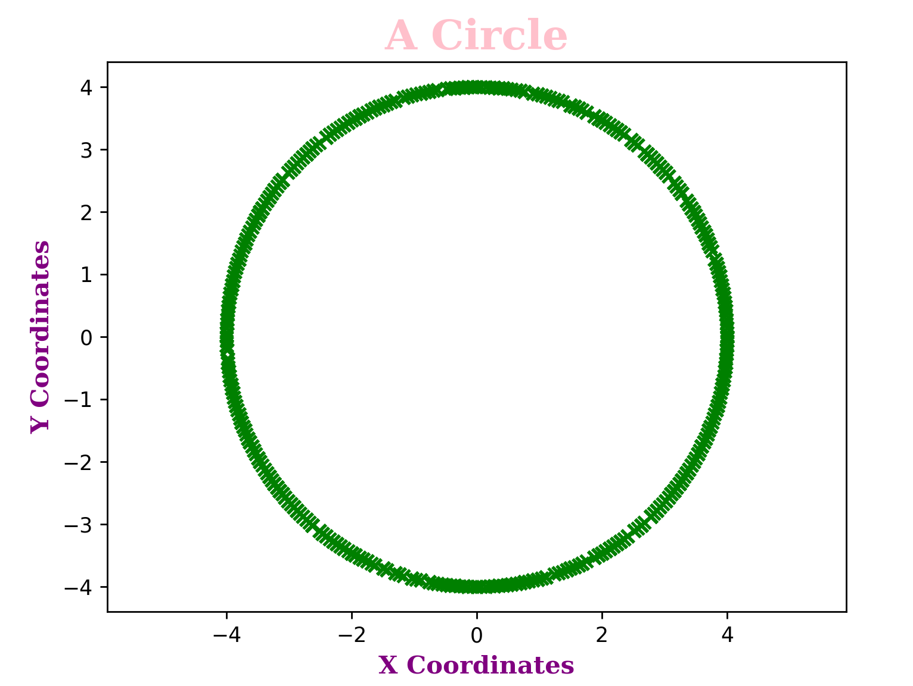
Sample plots from function output
N = 20 points
Eq. spacing
N = 20 points
Random spacing
N = 100 points
Eq. spacing
N = 1000 points
Eq. spacing
N = 10000 points
Random spacing

Slide 11


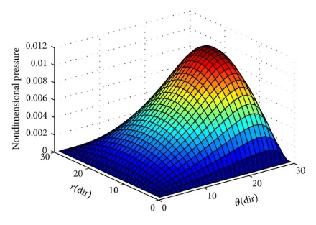
Impact of Numerical Methods at GE Research
Numerical methods can support a variety of applications such as:
Data Processing
Position, velocity, acceleration data (numerical integration)
Modeling and Characterization
Solving differential equations
Navier Stokes, Reynolds Eqn. (etc.)
Finite element analysis
Newton Raphson schemes
Forecasting and Projections
Lifing of mechanical components
https://www.google.com/url?sa=i&url=https%3A%2F%2Fwww.hindawi.com%2Fjournals%2Fisrn%2F2014%2F157615%2F&psig=AOvVaw2aNwglBezJ0NB5fqZKnwo2&ust=1670371193816000&source=images&cd=vfe&ved=0CAwQjRxqFwoTCMD1-uDX4_sCFQAAAAAdAAAAABAD
Most teams at GRC are using some form of numerical methods!
Above are just a few examples…

